Slide 1
Model Comparison
The two main factors investigated
Effect of epoch size (ES)
Effect of learning rate (LR)
Misc features:
Model structure is kept the same for all models.
Data is put through data augmentation to make the model better at coping with image variance.
Batch size is fixed at 32.
No callbacks are implemented in the early stages:
No early-stopping
No ‘ReduceLROnPlateau’
Validation sets are used for basic model evaluation during training

Slide 2
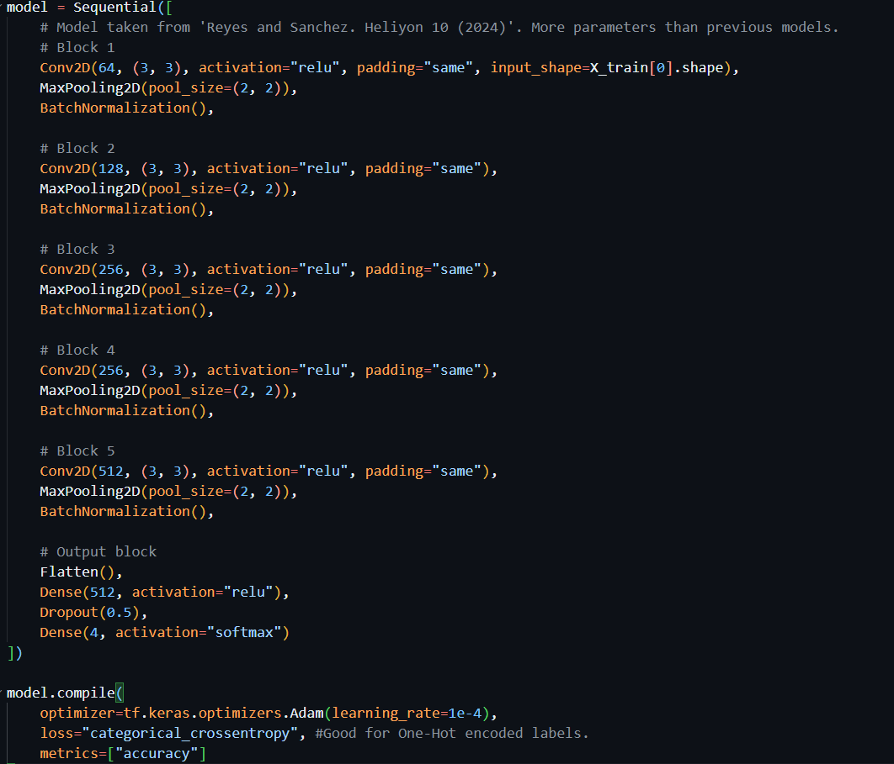
Model Structure
Learning rate = 1x10⁻⁴ , 1x10⁻⁵ , 1x10⁻⁶

Slide 3
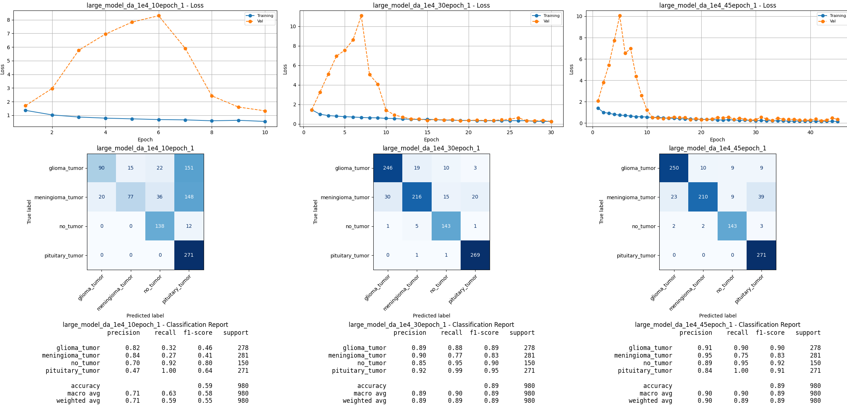
Model Comparison: Epoch Size
LR = 1x10⁻⁴ , ES = 10, 30, 45

Slide 4
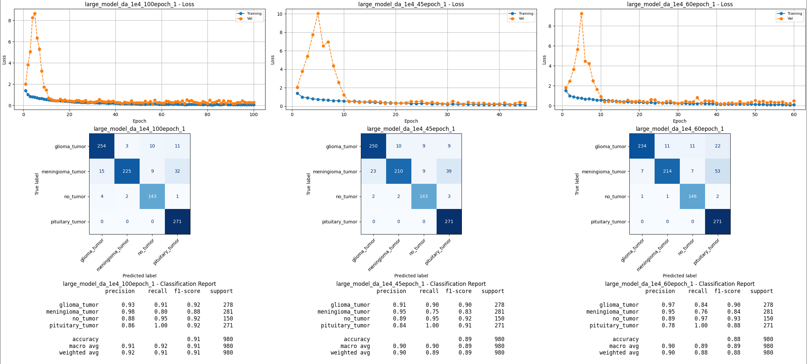
Model Comparison: Epoch Size
LR = 1x10⁻⁴ , ES = 45, 60, 100

Slide 5
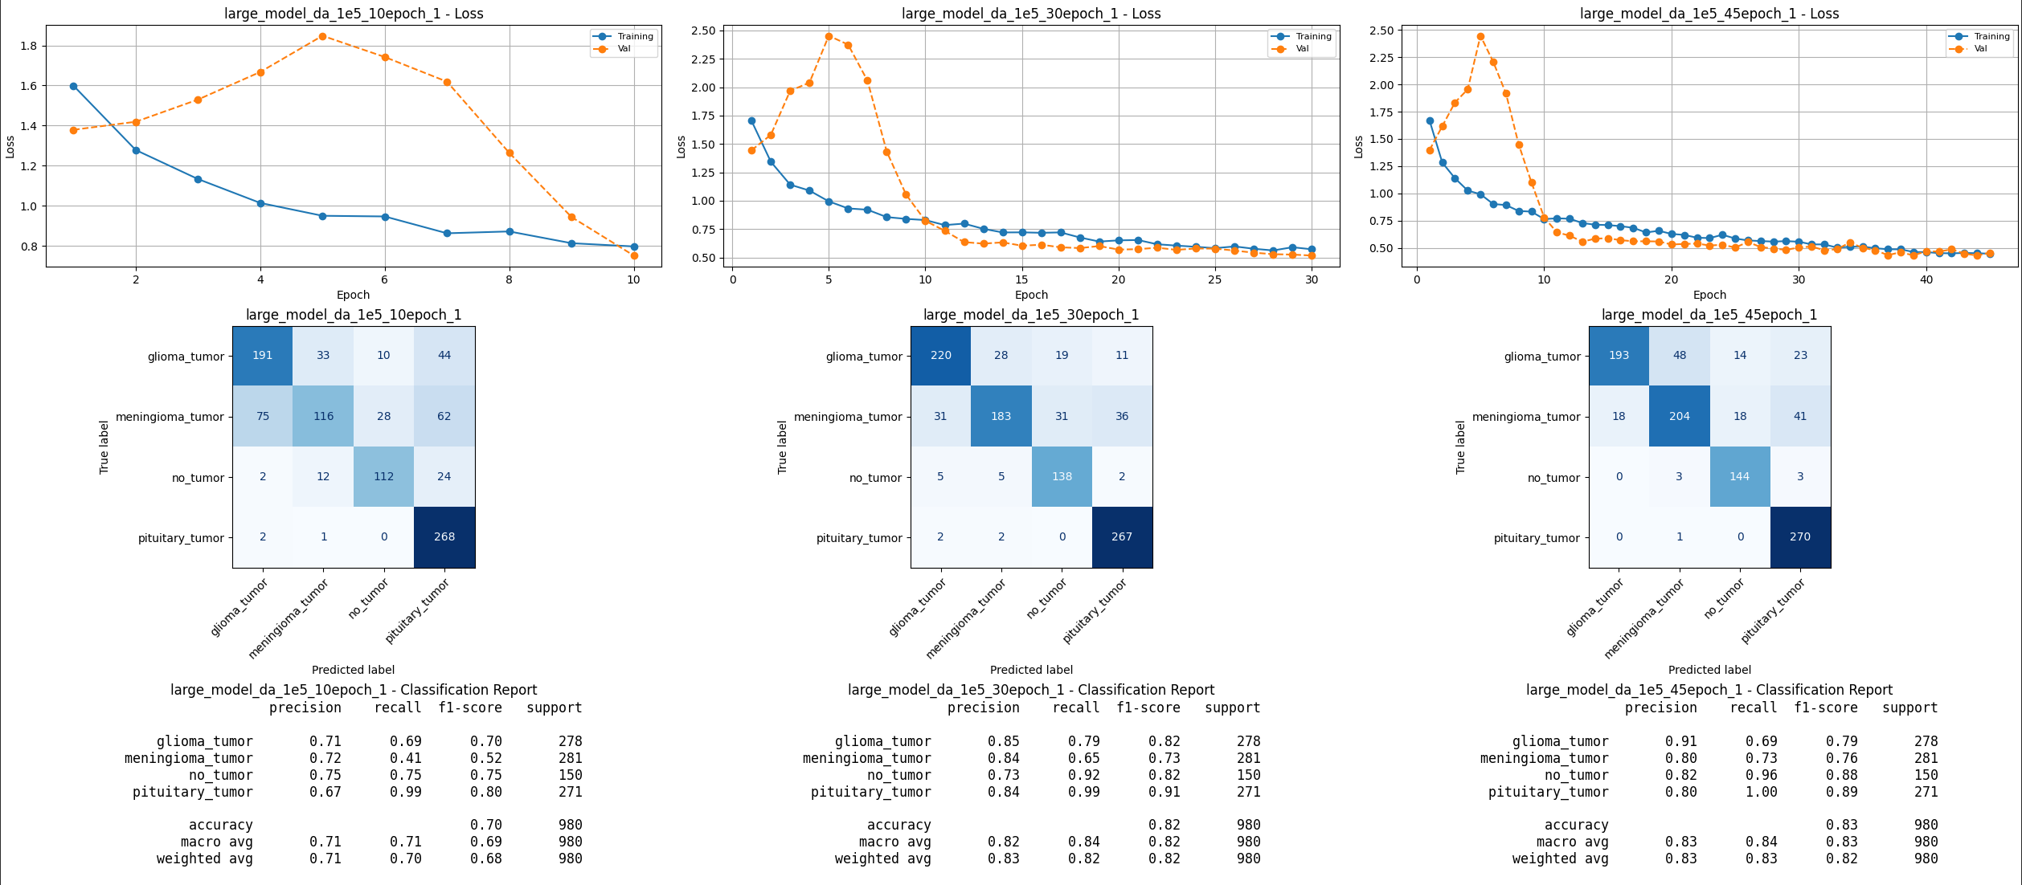
Model Comparison: Epoch Size
LR = 1x10⁻⁵ , ES = 10, 30, 45

Slide 6
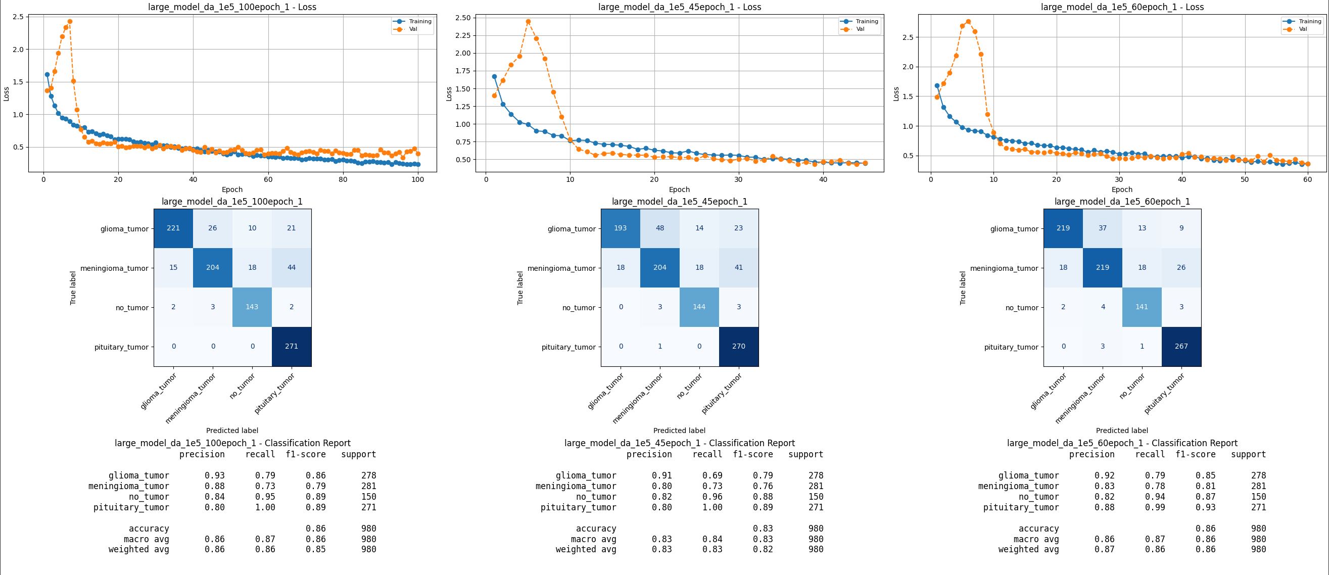
Model Comparison: Epoch Size
LR = 1x10⁻⁵ , ES = 45, 60, 100

Slide 7
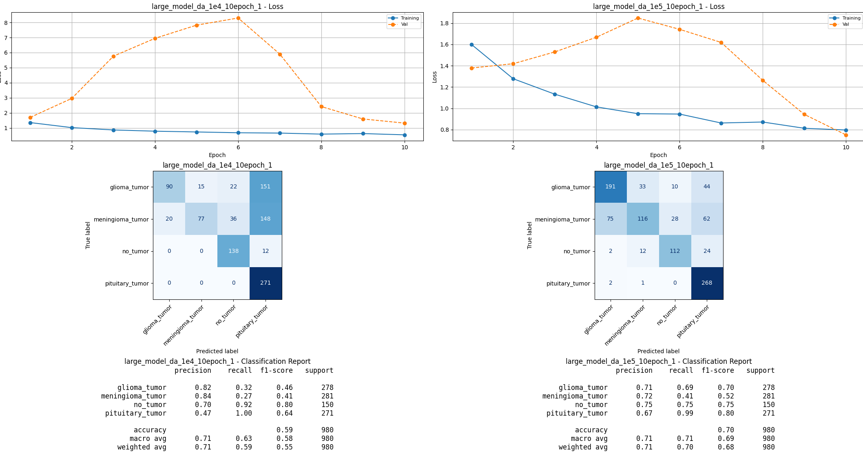
Model Comparison: Learning Rate
LR = 1x10⁻⁴, 1x10⁻⁵ , ES = 10

Slide 8
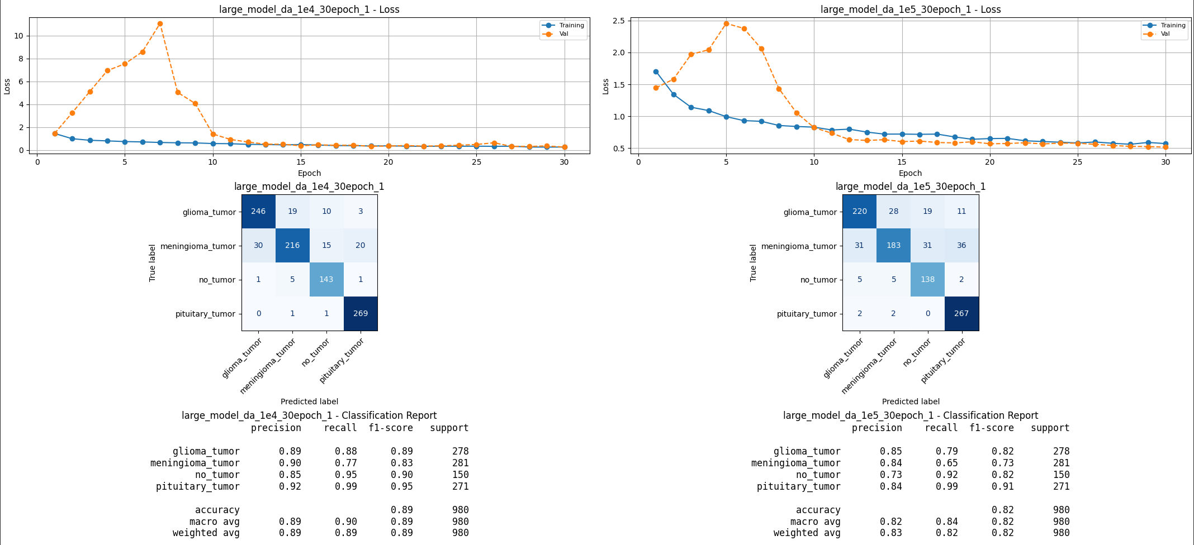
Model Comparison: Learning Rate
LR = 1x10⁻⁴, 1x10⁻⁵ , ES = 30

Slide 9
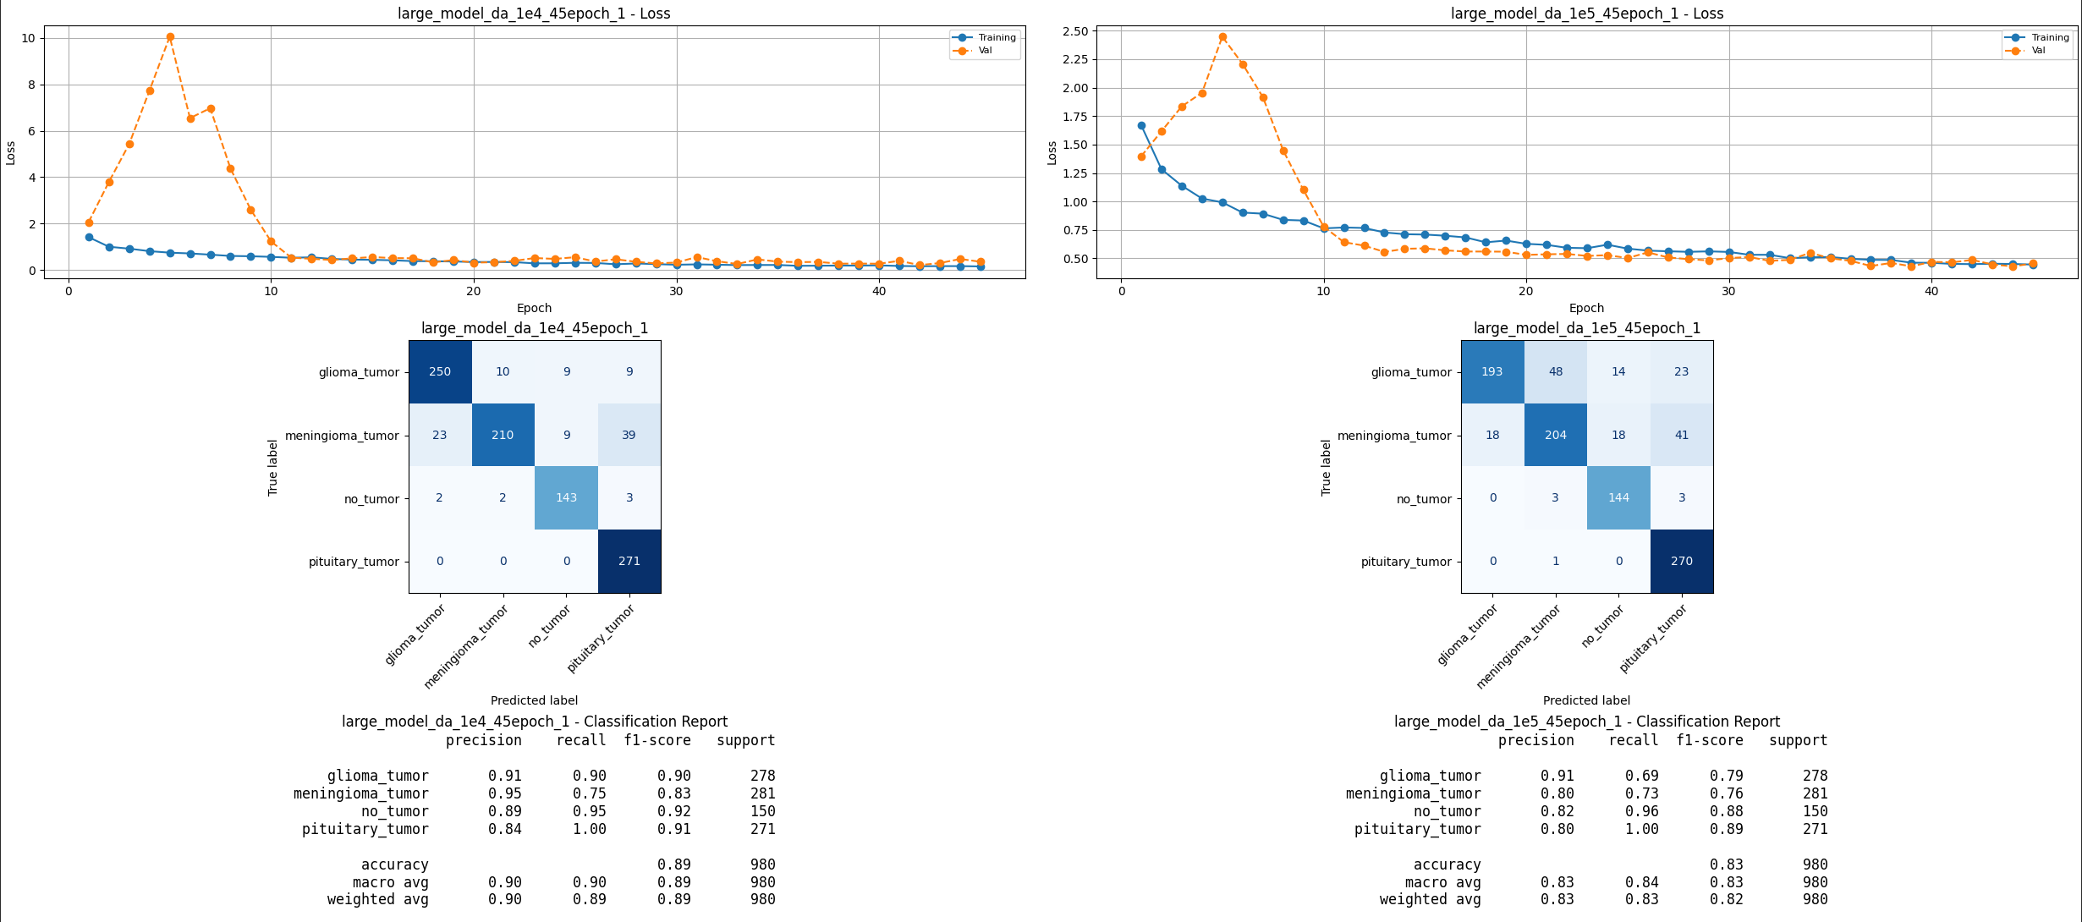
Model Comparison: Learning Rate
LR = 1x10⁻⁴, 1x10⁻⁵ , ES = 45

Slide 10
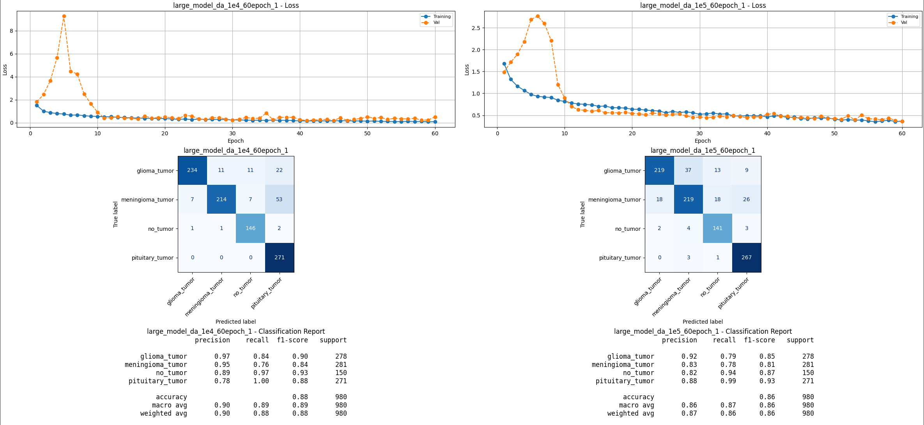
Model Comparison: Learning Rate
LR = 1x10⁻⁴, 1x10⁻⁵ , ES = 60

Slide 11
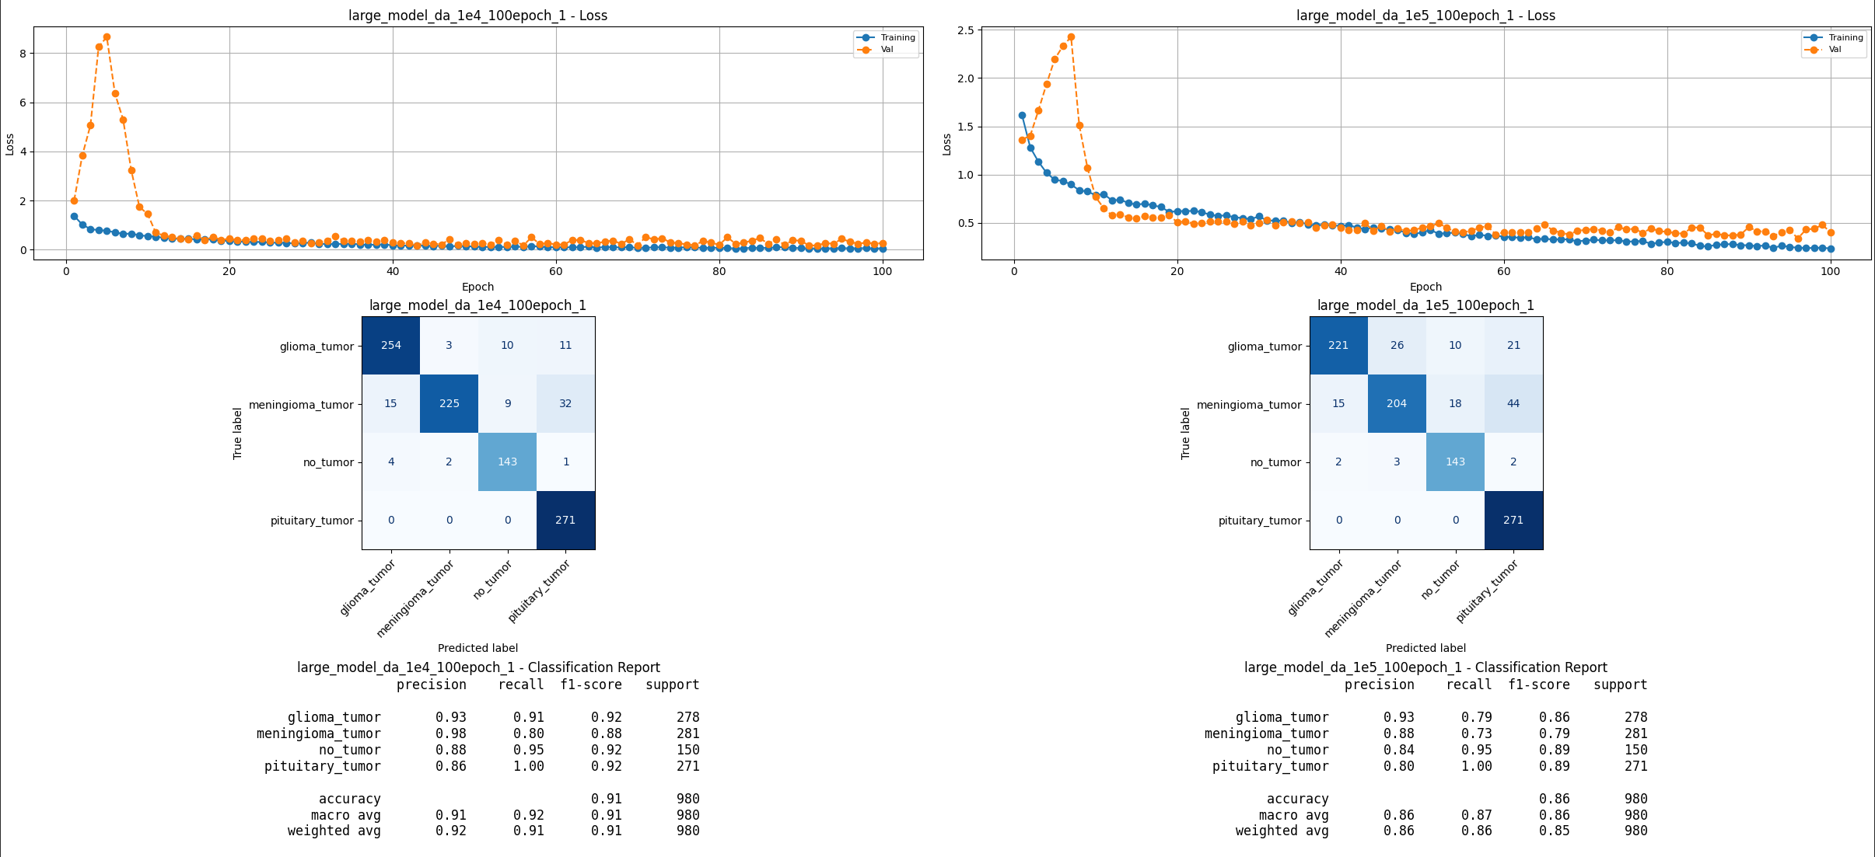
Model Comparison: Learning Rate
LR = 1x10⁻⁴, 1x10⁻⁵ , ES = 100

Slide 12
Decreasing LR to 1x10⁻⁶

Slide 13
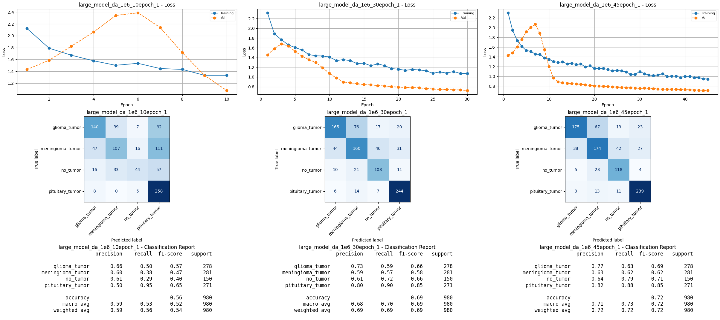
Model Comparison: Epoch Size
LR = 1x10⁻⁶ , ES = 10, 30, 45

Slide 14
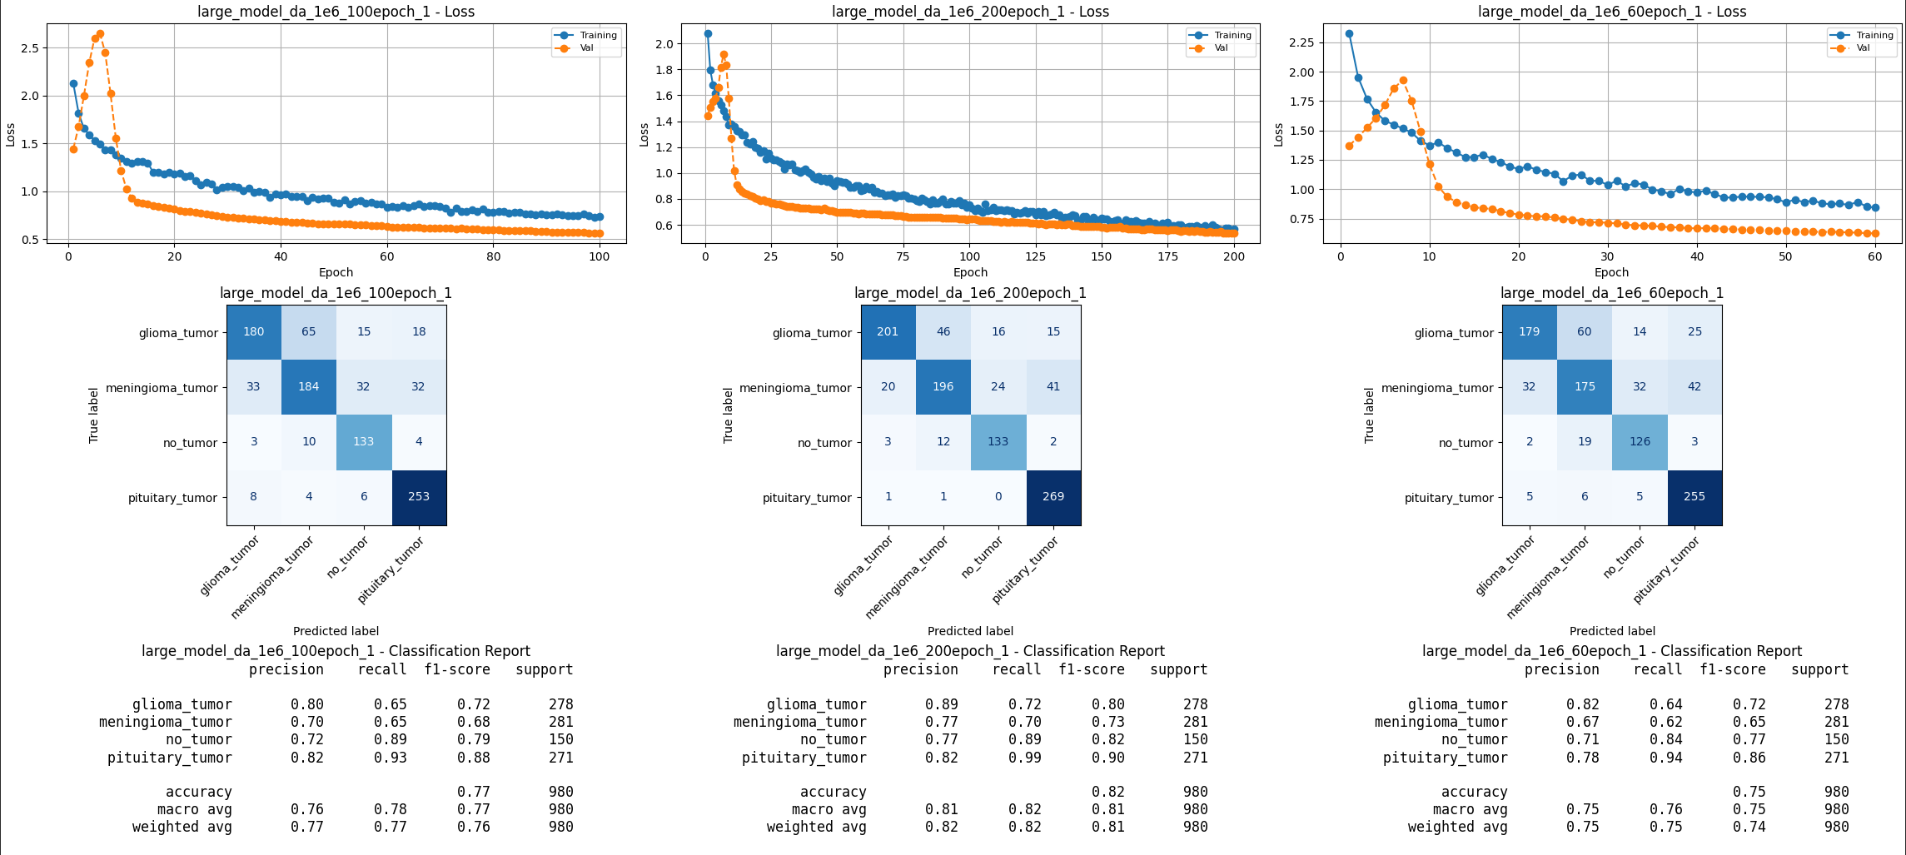
Model Comparison: Epoch Size
LR = 1x10⁻⁶ , ES = 60, 100, 200
Notes:
Lower learning rate = more epochs needed for full fitting (current problem here is underfitting). Could try a 300 epoch run? May take a while. Best bet is to start implementing callbacks.

Slide 15
Implementing Callbacks

Slide 16
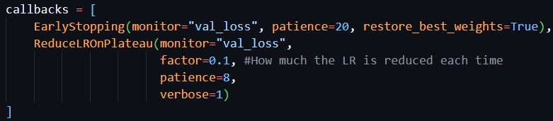
Callbacks: Reduce Learning Rate on Plateau (RLROP) and Early Stopping (ES)
Strategy
Create a model with a LR of 1x10-4 with lots of epochs (100) and implement:
RLROP
RLROP + ES

Slide 17
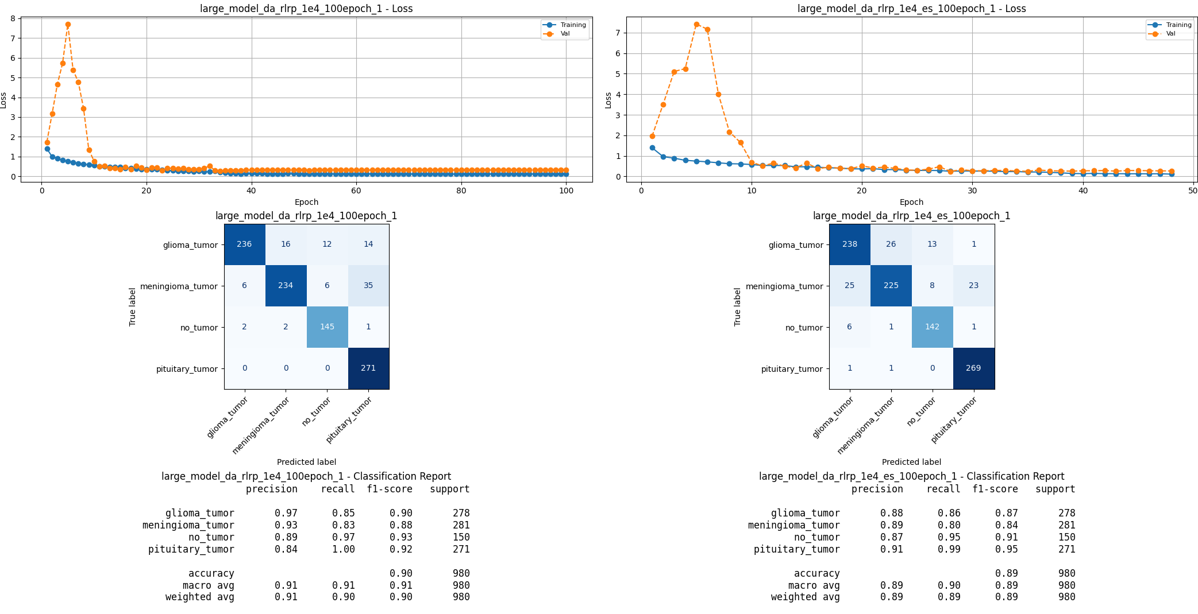
Model Comparison
RLROP and ES

Slide 18
Comparison Summary

